Slide 1
IMDB Movie Analysis
Manan Yadav
yadavmry5051@gmail.com​

Slide 2
Project Description
In the project we need to do various analyses on the IMDB movies dataset, to get some useful sights about various things like the best director who has the highest IMDb score based on the movies he/she made.
There are various columns in the dataset showing different metrics and stats about the movies and how the movie performed, how much was the budget to make that movie, the actors, the gross earning that the movie made, the IMDB rating of the movie, etc.
I need to find various parameters like popular genres, the critic’s favorite and the audience’s favorite actor, the IMDB top 250 movies, etc.

Slide 3
Approach
First of all the goal was to study the dataset thoroughly and get to know the columns that are needed to get the desired insights and eliminate the useless columns to clear the cluster. After that, I checked for null and duplicate values and eliminated the ones I found. Then use different formulas to get different insights.

Slide 4
Tech stack used
Microsoft Excel 2019
Microsoft PowerPoint 2019

Slide 5
Understanding the dataset
Before Cleaning –
Total Number of rows- 5044
Total Number of columns- 28
After Cleaning –
Total Number of rows- 3765
Total Number of Columns- 13
In the process of cleaning, 44 duplicates were removed and 3765 rows were obtained after removing the rows having blank cell and the unnecessary columns were dropped.

Slide 6
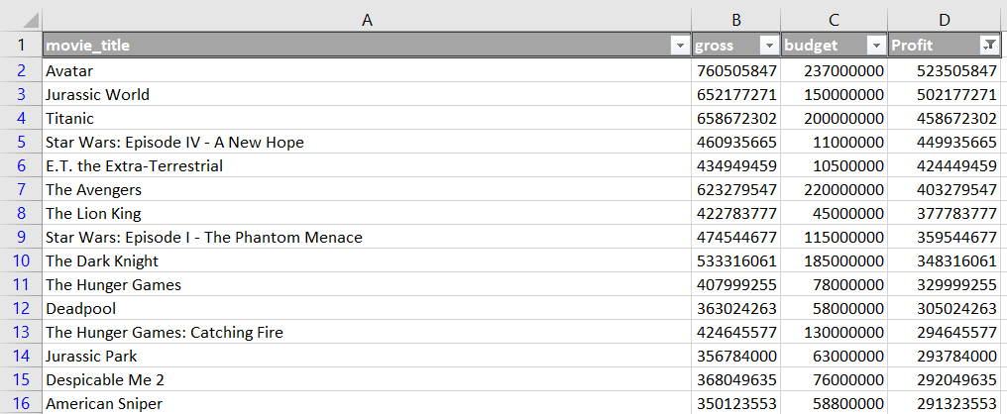
Most profitable movie

Slide 7
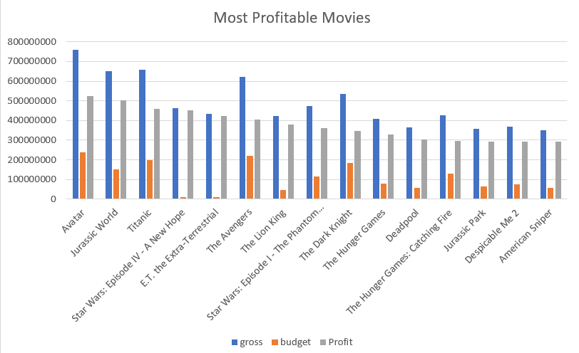

Slide 8
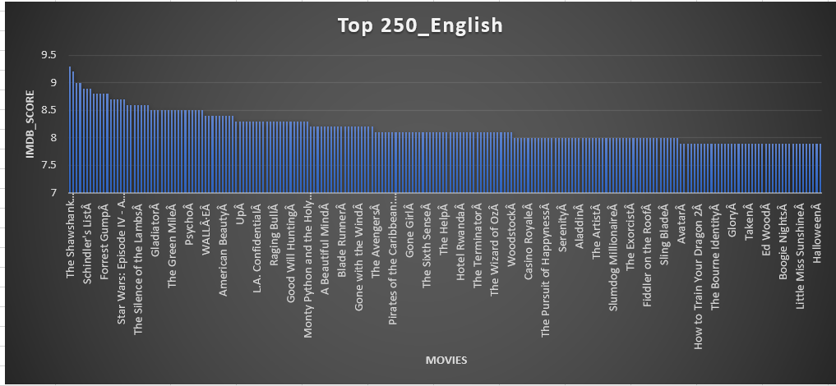
The Shawshank Redemption is the best English movie with an average IMDB score of 9.3.

Slide 9
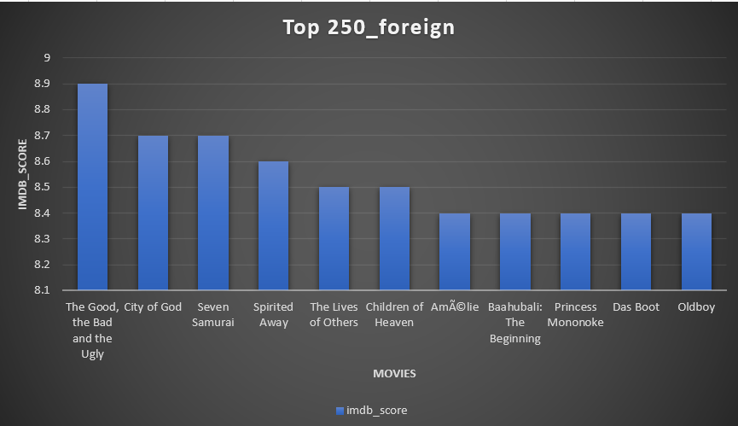
The good, the bad and the ugly is the best foreign movie with an average IMDB score of 8.9

Slide 10
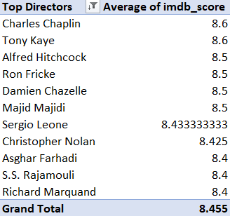
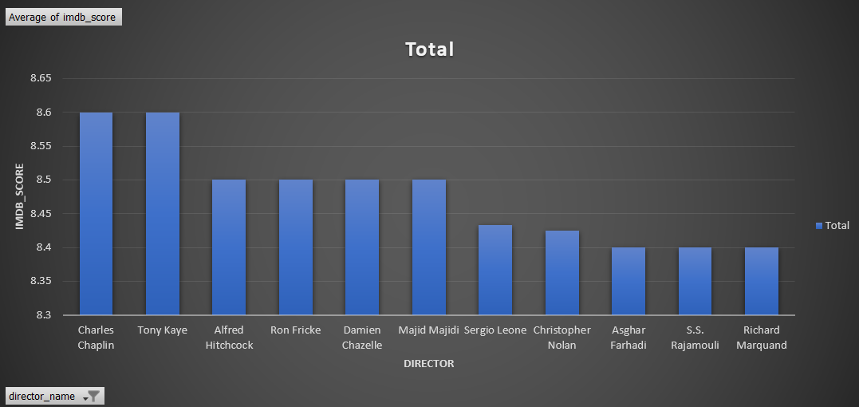
Below shown are the top 10 directors with the highest average IMDb score.

Slide 11
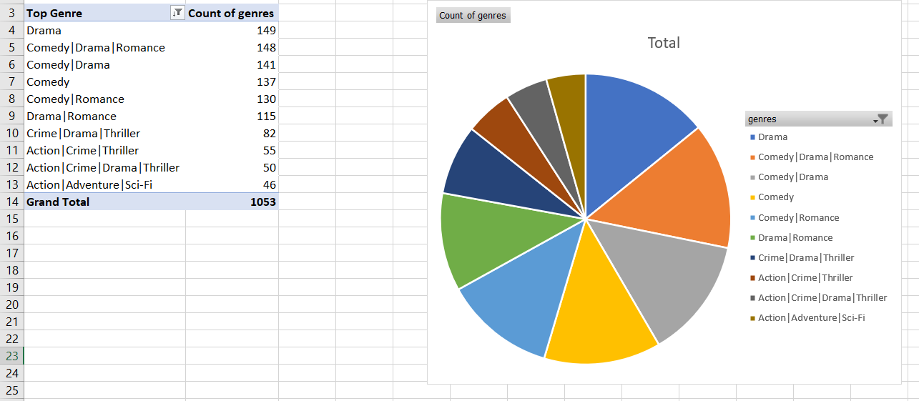
Popular GENRES

Slide 12
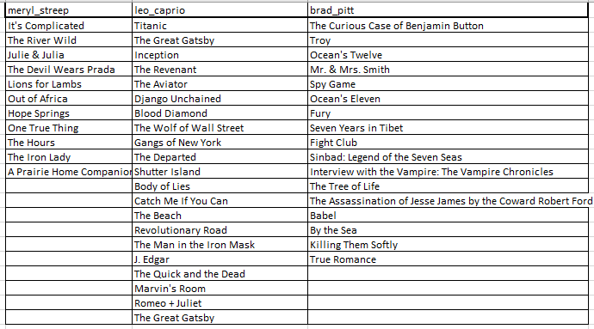
Actor analysis
Meryl Streep – 11
Leonardo DiCaprio – 21
Brad Pitt – 17

Slide 13
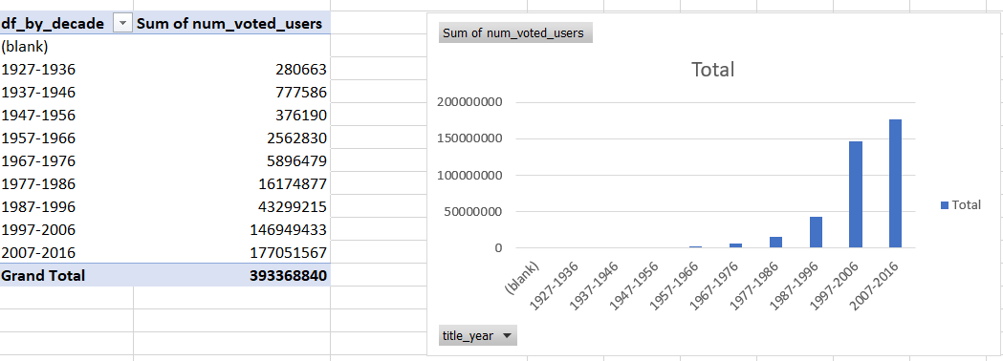
Decade analysis

Slide 14
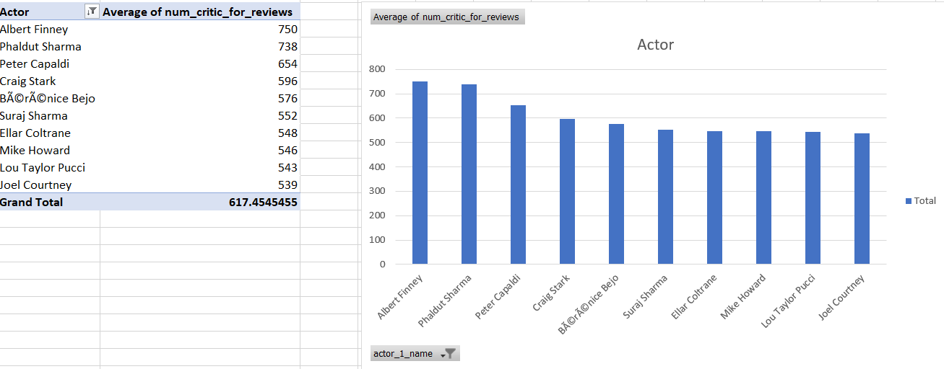
Critic favorite actor

Slide 15
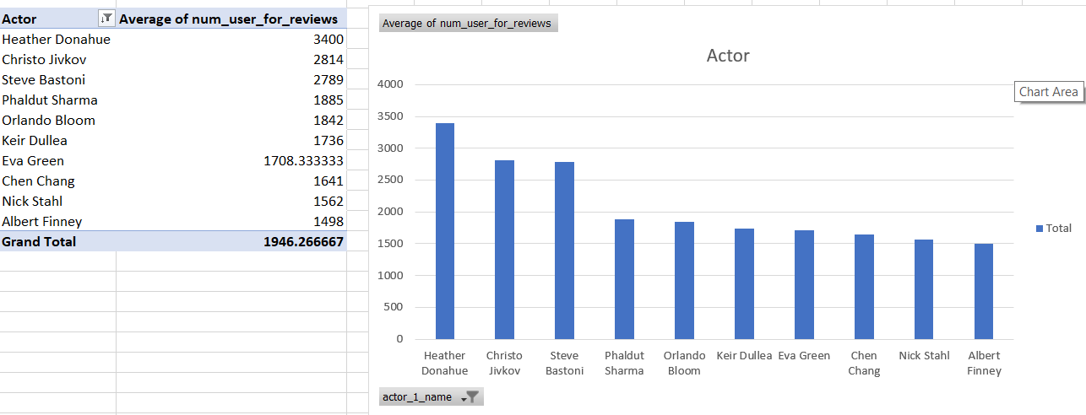
Audience Favorite actor

Slide 16
Insights
Through this project I learned about various functions and formulae in excel which can be used to get various insights through any dataset given and how the same functions can be used to get different insights depending on how we use it in the given dataset.
The importance of cleaning the data before we analyze it to derive various insights from it, if not done properly then the insights could be incorrect and may produce misleading results.
Studying the data set and understanding which columns are useful and which columns are there just creates a cluster and eliminates useless data so the process of analysis is easier.

Slide 17
Results
Through this project I get to know how we can use different functions in different ways to manipulate the data as per our needs and derive various insights which show us important parameters. I have now gained good knowledge about various tools in functions in excel and the process of manipulating the data and using that to create various data visualizations to present the insights in a visually appealing manner.

